Slide 1
TCP Sockets (part 2)
Connection-related functions, Socket options, TCP client-server and Concurrent servers.
Chapter 4 and 5

Slide 2
Recap
Connect
Bind
Listen
Accept
Fork
Concurrent Servers

Slide 3
Concurrent Servers
bind(listenfd,(struct sockaddr *)&serverAddress, sizeof(serverAddress));
listen(listenfd,5);
while(1){
//...
connfd=accept(listenfd,(struct sockaddr*)&clientAddress,&clientAddressLength);
if ( (pid=fork()) == 0) {
close(listenfd);
doit(connfd);
close(connfd);
exit(0);
}
close(connfd);//sock is closed BY PARENT
}
Server
Client
connect()
listenfd
parent
connfd
fork
Server
listenfd
child
connfd

Slide 4
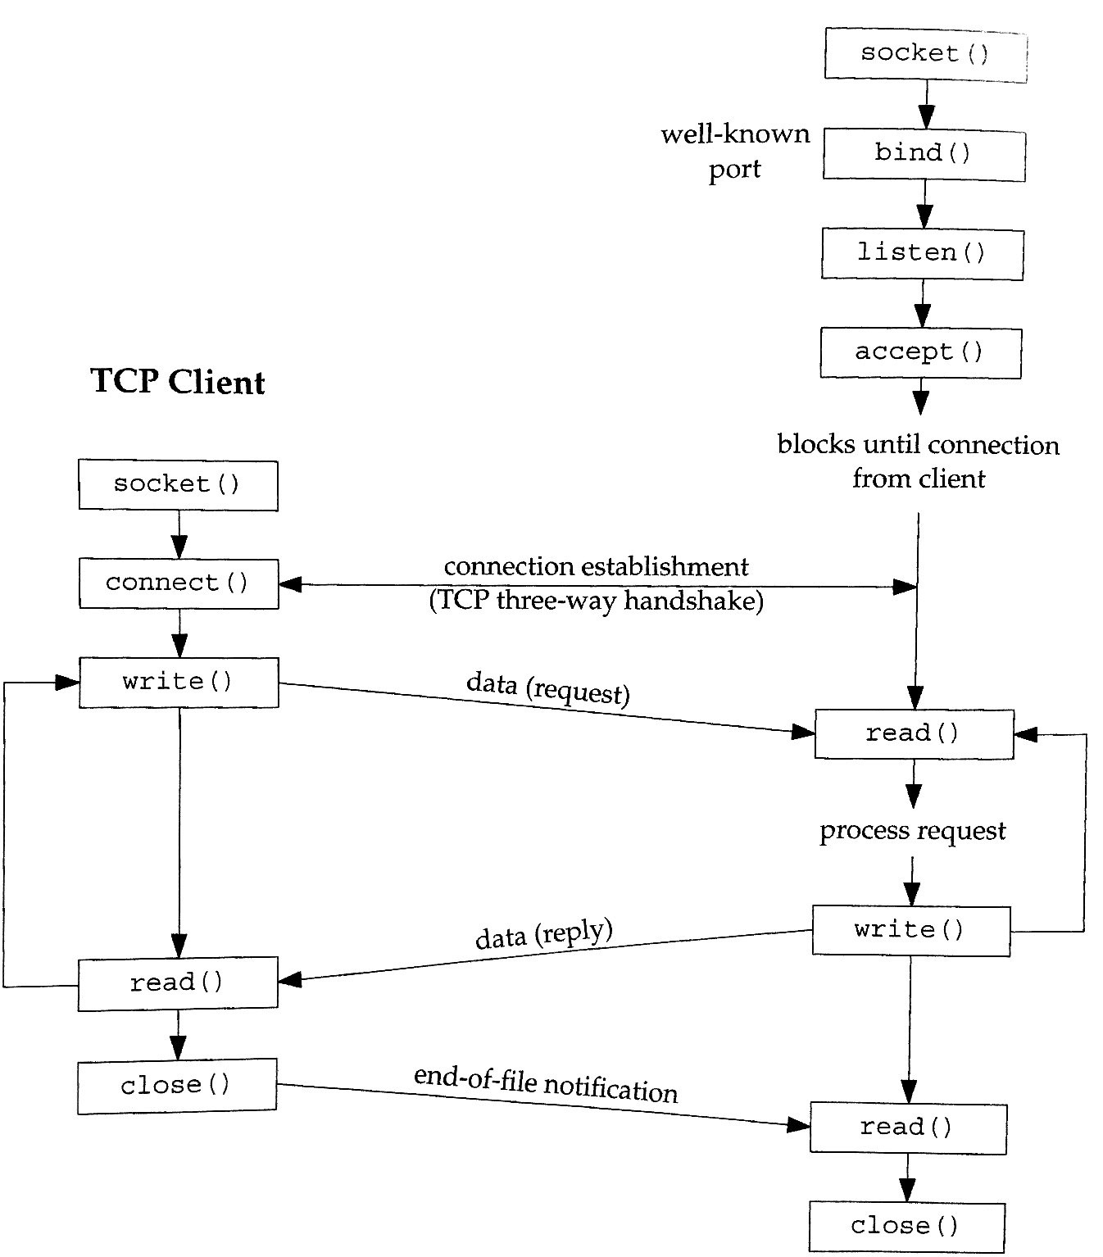

Slide 5
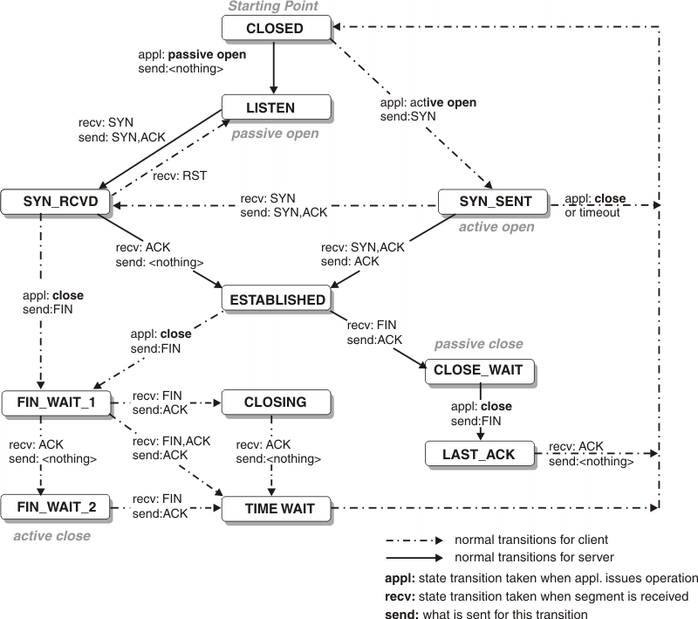
close()
#include <unistd.h>
int connect(int sockfd);
Mark socket as closed and return.
Send (try) any outstanding data.
Initiate TCP disconnect (reverse handshake)
SO_LINGER
Descriptor Reference Count
Shutdown()

Slide 6
#include <sys/socket.h>
int getsockname(int sockfd, struct sockaddr *localaddr, socklen_t *localaddrlen);
int getpeername(int sockfd, struct sockaddr *peeraddr, socklen_t *peerlen);
Obtain the local | foreign protocol address.
inetd
inetd(child)
Peer’s address
fork
Peer’s address
connfd
= accept( )
connfd
exec
“Peer”
getsockname()
Telnet
server
connfd
getpeername()

Slide 7
Example
$netstat -an
Active Connections
Proto Local Address Foreign Address State
TCP 0.0.0.0:135 0.0.0.0:0 LISTENING
TCP 0.0.0.0:445 0.0.0.0:0 LISTENING
TCP 0.0.0.0:2179 0.0.0.0:0 LISTENING
TCP 0.0.0.0:3389 0.0.0.0:0 LISTENING
TCP 192.168.1.149:49182 192.168.1.111:8009 ESTABLISHED
TCP 192.168.1.149:49183 192.168.1.104:8009 ESTABLISHED
TCP 192.168.1.149:49209 52.112.194.82:443 ESTABLISHED
TCP 192.168.1.149:49408 40.67.251.134:443 ESTABLISHED
TCP 192.168.1.149:54374 2.20.73.33:443 CLOSE_WAIT
TCP 192.168.1.149:54375 2.20.74.239:80 CLOSE_WAIT
Peer
TCP State

Slide 8
TCP Client/Server
int main(){
int listenfd;//to create socket
int connfd;//to accept connection
childCnt=0;
struct sockaddr_in serverAddress;//server receive on this address
struct sockaddr_in clientAddress;//server sends to client on this address
struct sockaddr_storage their_addr;
int n;
char msg[MAXSZ];
int clientAddressLength;
int pid;
char cli[INET6_ADDRSTRLEN];
char s[INET6_ADDRSTRLEN];
External Viewer
concurr-tcp.c

Slide 9
TCP Client/Server
memset(msg,'A',MAXSZ);
msg[MAXSZ-1]='\n';
listenfd=socket(AF_INET,SOCK_STREAM,0); //create socket
memset(&serverAddress,0,sizeof(serverAddress)); //initialize the socket addresses
serverAddress.sin_family=AF_INET;
serverAddress.sin_addr.s_addr=htonl(INADDR_ANY);
serverAddress.sin_port=htons(PORT);
//bind the socket with the server address and port
bind(listenfd,(struct sockaddr *)&serverAddress, sizeof(serverAddress));
listen(listenfd,5); //listen for connection from client
External Viewer
concurr-tcp.c

Slide 10
TCP Client/Server
while(1) { //parent process waiting to accept a new connection
clientAddressLength=sizeof(clientAddress);
connfd=accept(listenfd,
(struct sockaddr*)&clientAddress,
&clientAddressLength);
printf("accept = %d \n", connfd );
childCnt++;
printf("listener: got packet from %s:%d\n",
inet_ntop(clientAddress.sin_family,
get_in_addr((struct sockaddr *)&clientAddress),
s, sizeof s),ntohs(clientAddress.sin_port));
//child process is created for serving each new clients
pid=fork();
External Viewer
concurr-tcp.c

Slide 11
TCP Client/Server
if(pid==0) {
get_ip_str((struct sockaddr*)&clientAddress,&cli,&clientAddressLength);
printf("Child[%d] (%s:%d): recv(%d) .\n", childCnt,cli,ntohs(clientAddress.sin_port),n);
while(1){
n=send(connfd,msg,MAXSZ,0);
printf("Child[%d] (%s:%d): Sent (%d) .\n", childCnt,cli,ntohs(clientAddress.sin_port),n);
sleep(1);
}//close interior while
exit(0);
}
else {
printf("Parent, close connfd().\n");
close(connfd);//sock is closed BY PARENT
}
}//close exterior while
return 0;
}
External Viewer
concurr-tcp.c

Slide 12
TCP Client/Server
/*
** client.c -- a stream socket client demo
*/
#include <stdio.h>
#include <stdlib.h>
#include <unistd.h>
#include <errno.h>
#include <string.h>
#include <netdb.h>
#include <sys/types.h>
#include <netinet/in.h>
#include <sys/socket.h>
#include <arpa/inet.h>
#define PORT "4950" // the port client will be connecting to
#define MAXDATASIZE 1401 // max number of bytes we can get at once
// get sockaddr, IPv4 or IPv6:
void *get_in_addr(struct sockaddr *sa)
{
if (sa->sa_family == AF_INET) {
return &(((struct sockaddr_in*)sa)->sin_addr);
}
return &(((struct sockaddr_in6*)sa)->sin6_addr);
}
int main(int argc, char *argv[])
{
int sockfd, numbytes;
char buf[MAXDATASIZE];
struct addrinfo hints, *servinfo, *p;
int rv;
char s[INET6_ADDRSTRLEN];
char trunk[]="[Trunkated]\0";
External Viewer
tcp_basic_client.c

Slide 13
TCP Client/Server
// loop through all the results and connect to the first we can
for(p = servinfo; p != NULL; p = p->ai_next) {
if ((sockfd = socket(p->ai_family, p->ai_socktype,
p->ai_protocol)) == -1) {
perror("client: socket");
continue;
}
if (connect(sockfd, p->ai_addr, p->ai_addrlen) == -1) {
close(sockfd);
perror("client: connect");
continue;
}
break;
}
if (p == NULL) {
fprintf(stderr, "client: failed to connect\n");
return 2;
}
if (argc != 2) {
fprintf(stderr,"usage: client hostname\n");
exit(1);
}
memset(&hints, 0, sizeof hints);
hints.ai_family = AF_UNSPEC;
hints.ai_socktype = SOCK_STREAM;
if ((rv = getaddrinfo(argv[1], PORT, &hints, &servinfo)) != 0) {
fprintf(stderr, "getaddrinfo: %s\n", gai_strerror(rv));
return 1;
}
External Viewer
tcp_basic_client.c

Slide 14
TCP Client/Server
int totalBytes=0;
while(1){
numbytes = recv(sockfd, buf, MAXDATASIZE-1, 0);
if(numbytes == -1 ){
perror("recv");
exit(1);
}
if (numbytes == 0) {
printf("Server closed.\n");
break;
}
totalBytes+=numbytes;
if (numbytes>10) {
memcpy(&buf[10],trunk,strlen(trunk)+1);
} else {
buf[numbytes] = '\0';
}
printf("client (%d/%d) : received '%s'\n",numbytes, totalBytes, buf);
}
close(sockfd);
return 0;
}
External Viewer
tcp_basic_client.c

Slide 15
Code Examples
https://github.com/patrikarlos/networkprogramming
Server; concurr-tcp-gen.c
Client; tcp_basic_client.c
$ git clone https://github.com/patrikarlos/networkprogramming.git
$ cd networkprogramming
$ make tcpbasicclient
$ make conlisten
$ ./conlisten
(different terminal)
$ ./tcpbasicclient 127.0.0.1

Slide 16
Summary
Basic TCP server
Basic TCP client

Slide 17
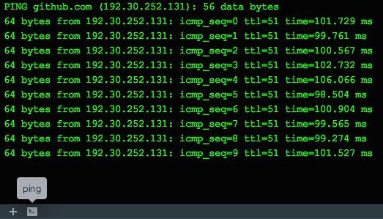
Live Operations
Client & Server,
Look at ps and netstat
Tcp states
Termination
‘reuse’

Slide 18
POSIX Signal Handling
Notification of events (software interrupts)
Asynchronous
Senders
Processes
Kernel

Slide 19
Signal Disposition / Action
Every signal has a disposition, or action associated with the signal. Set by SigAction.
Function, catch the signal.
SIGKILL/SIGSTOP cant be caught
Called with an integer argument
Ignore
SIGKILL/SIGSTOP cant be ignored
Default, normally reception of any signal it to terminate process.

Slide 20
POSIX Signal Semantics
Once installed it remains
While a signal handler is executing, the signal delivered is blocked.
If a signal is generated 1….N while blocked, only one will be delivered.
We can block and unblock signals (sigprocmask)

Slide 21
SIGCHLD
Zombie / defunct processes
Obtain info about dead process (i.e. why, resources, etc… )
Register SIGCHLD and action
before fork!!

Slide 22
Interrupted System Calls
Any time and Any Where.
int written = write(filedes, buf, size);
if (written == -1) {
if (errno == EINTR) {
continue;
}
return -1;
}

Slide 23
Wait & Waitpid
#include <sys/wait.h>
pid_t wait(int *statloc);
pid_t waitpid(pid_t pid, int *statlock, int options)
wait() and waitpid()
The wait() system call suspends execution of the calling thread
until one of its children terminates.
The call wait(&wstatus) is equivalent to:
waitpid(-1, &wstatus, 0);
The waitpid() system call suspends execution of the calling thread
until a child specified by pid argument has changed state. By
default, waitpid() waits only for terminated children, but this
behavior is modifiable via the options argument.
wait(): on success, returns the process ID of the terminated child; on error, -1 is returned.
waitpid(): on success, returns the process ID of the child whose state has changed;
if WNOHANG was specified and one or more child(ren) specified by pid exist, but have not
yet changed state, then 0 is returned. On error, -1 is returned.

Slide 24
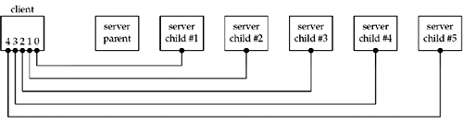
Difference Wait & Waitpid

Slide 25
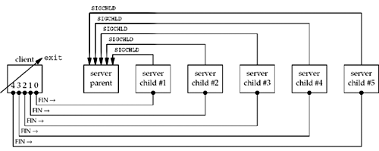
Difference Wait & Waitpid

Slide 26
Catch all Children
while ( (pid = waitpid(-1, &stat, WNOHANG) ) > 0 ){
printf(”RIP Child %d .\n”, pid);
}

Slide 27
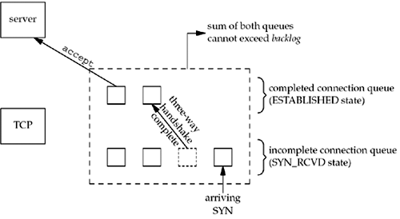
Connection Abort before Accept
Client
Server
Socket
Connect(blocks)
Socket, bind, listen
LISTEN (passive open)
SYN
SYN, ACK
SYN_RCVD
Connect returns
ACK
ESTABLISHED
RST
Accept called
Implementation/Platform Dependent

Slide 28
Termination of Server Process
Parent
listenfd
Spawns
Child1
connfd
SYN
ACK
SYN+ACK
FIN
RST
Client

Slide 29
SIGPIPE (broken pipe)
Parent
listenfd
Spawns
while(fgets(sendline,ML,fp)!=null){
write(sockfd, sendline,1);
sleep(1);
write(sockfd, sendline+1,strlen(sendline)-1);
if (readline(…) ){
err_quit();
}
fputs()
}
Fig. 5.14
Child1
connfd
SYN
ACK
SYN+ACK
FIN
RST
Client
Write/send
Broken pipe

Slide 30
Crashing, Rebooting and Shutdown of Server
Parent
listenfd
Spawns
Child1
connfd
SYN
ACK
SYN+ACK
A
A
…
A
Client
retransmit
retransmit
Error:
ETIMEDOUT
EHOSTUNREACHABLE
ENETUNREACHABLE
ICMP

Slide 31
Crashing, Rebooting and Shutdown of Server
Parent
listenfd
Spawns
Child1
connfd
SYN
ACK
SYN+ACK
RST
A
A
Client
retransmit
Error:
ECONNRESET

Slide 32
Crashing, Rebooting and Shutdown of Server
SIGKILL
SIGTERM
SIGHANDLER
Shutdown
Parent
listenfd
Spawns
FIN
Child1
connfd
FIN
SYN
ACK
FIN
SYN+ACK
RST
Client

